Slide 1
Mobile Technology Products Services Training

Slide 3
Effective iPhone App Development
Suman B.K, iPhone Team Lead

Slide 4
I want all features on my App!!

Slide 5
Topics
Data Modelling
MVC-Design Patterns
Delegates & Notifications
Memory Management & Performance.

Slide 6
Data Modelling-
Choosing the right Data Model
Data Model

Slide 7
Different kinds of Data
Data Forms | Nature
User | Images, Audio & Video files
User Preference | Saves app state information
Sensitive | User Name & Password
Cache | Data will be cached to the proper location .

Slide 8
User Data
User controlled data
Unstructured Text files
Property Lists
XML
Archiving(NScoding)
SQlite
CoreData

Slide 9
Property Lists
“plist”
Its mainly for Small Data.
Object←----Attributes←--- organize.

Slide 10
XML files
Light weight structured format that your app can easily read & write
Also it easily fits into iOS
NSXML, Libxml & Tiny xml parser available.

Slide 11
SQLite
Light weight yet powerful database engine.
Used in countless applications across many platforms.
SQLite uses a procedural Data

Slide 12
CoreData
It’s a Built-In Data model ,available on MAC OS & iPhone OS 3.0 onwards.
Large or small kinds of DataSet.
Object Oriented Format.
Built-in SQLite data library.

Slide 13
User Preference
Saves the state Information.
It Make Use of NSUserDefaults
Light weight settings.
No heavy data-No Images or No video files

Slide 14
Sensitive Data
Keychain is the place holder for the sensitive data.
All the data is encrypted
Best to keep password ,licence key etc.
Backs up data when app is re-installed.

Slide 15
Cached Data
Store data in the proper location.
Location: NSPathUtilities.h
Important: No Hardcoded path

Slide 16
3 directories
NSTemporaryDirectory : Cleared by the System but not backed up.
NSCachesDirectory : Saved in the directory but not backed up.
NSDocumentDirectory : Saved in directory and Backed up.

Slide 17
MVC – Design Patterns
MVC Model-View-Controller.
Best suited for iPhone Apps.
Object communication.

Slide 18
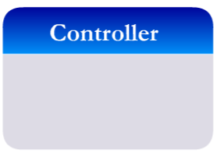
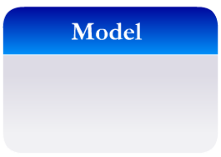

Slide 19
Why is MVC used?
Independent development modules.
Reusable interface, application logic, and data set.
reliable,flexible and robust code.

Slide 20
Model
Model objects encapsulate the data.
It manipulates and process the data.
It Communicates with Controller.
One-to-one and one-to-many .

Slide 21
View
Displays UI and responds to user
view objects are typically decoupled from model objects.
Purpose:
Display data from the application’s model objects and
Enable the editing of that data.

Slide 22
Controller
Intermediate between View & Model Objects.
Loads the View and also connects model to view.
Manages the flow of the APP.
Function:
Setup and coordinating tasks for an application and
Manage the life cycles of other objects.

Slide 23
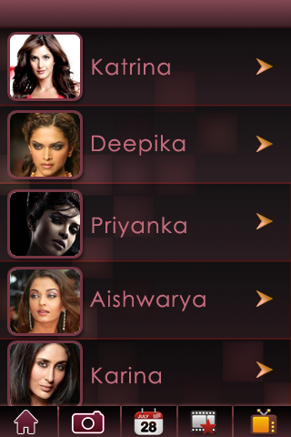
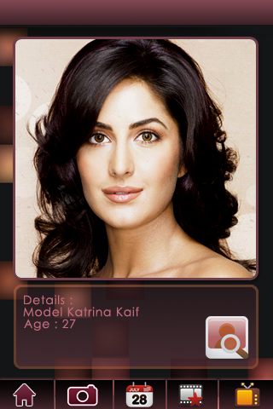
My Simple Application

Slide 24
Application Flow

Slide 25
UIView Controller
Its a Basic Building block.
One Screen One View Controller
Subclass to add your application logic
It encapsulates your data, view & logic
It Manages the Orientation
It Connects model to the view

Slide 26
UINavigation Controller

Slide 27
My Favorite Actress –Information Flow
Model Object:
Class Actress
. Name NSString
. Age int
. Details NSString
. Hobbies List
No of Movies int

Slide 29
Code
- (BOOL)application:(UIApplication *)application didFinishLaunchingWithOptions:(NSDictionary *)launchOptions
{
actressListController=[[[ActressListTableViewController] alloc] init];
actressListController.managedObjectContext=self.managedObjectContext;
[navigationController pushViewController:actressListController animated:no];
return YES;
}

Slide 31
Code
- (void)tableView:(UITableView *)tableView didSelectRowAtIndexPath:(NSIndexPath *)indexPath
{
ActressData *actressData=[fetchedResultController objectAtIndexPath:indexPath];
ActressDetailViewController *advc=[[ActressDetailViewController alloc] init];
ActressDetailViewController.actressData= actressData;
self.actressDetailViewController= advice;
[self.navigationController pushViewController: advc animated:no];
[advc release];
}

Slide 33
Delegates and Notifications

Slide 34
Protocols
Set of rules to communicate between the objects.
Its similar to java interface.
It avoids subclassing.
It allows two classes distantly related by inheritance to communicate with others.

Slide 35
What is Delegate?
Powerful Design Pattern which preserves MVC structure.
It s mainly used to communicate between the two objects.
Delegate is implemented using a protocol.

Slide 36
How does Delegate Work?
The delegating class has an outlet or property, usually one that is named delegate.
During an event, Delegating object sends the Message to delegate.
Message is sent only if the delegate implements the method.
One-to-One Communication Path

Slide 37
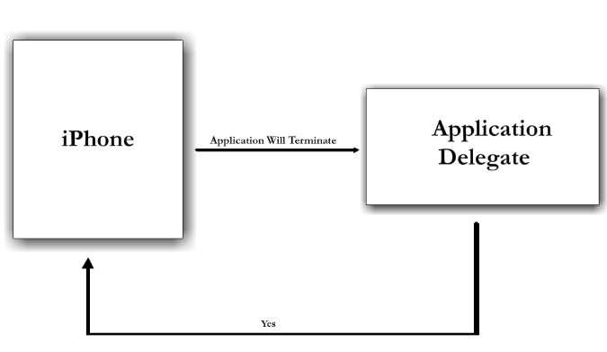

Slide 38
Notifications
Broadcast model= One-to-many
Sent Application – wide , not to a specific class.

Slide 39
How does Notification Work?
Simple Mechanism.
Process has an object called notification center.
Objects register with the notification centre in order to be notified

Slide 40
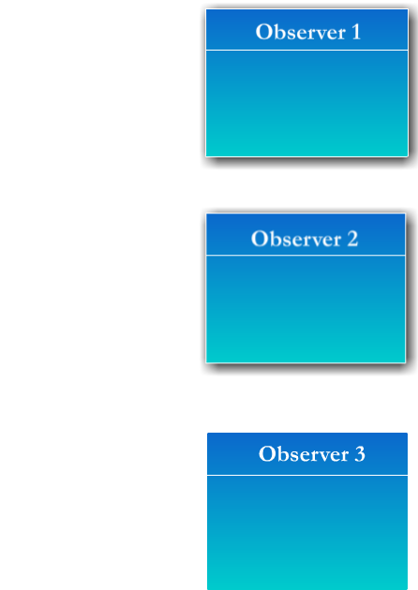
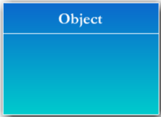
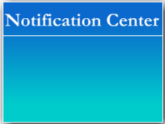

Slide 41
Memory Management
3 important things.
Problem identification.
Analysis Tools.
Handling in ViewControllers

Slide 42
Identify the problems
Check for crashes.
CrashLogs without backtrace.
Messages in the Console

Slide 43
Analysis Tools
How much memory is utilized in runtime
Analysis tools can be used on Simulator too

Slide 44
Analysis Tools

Slide 45
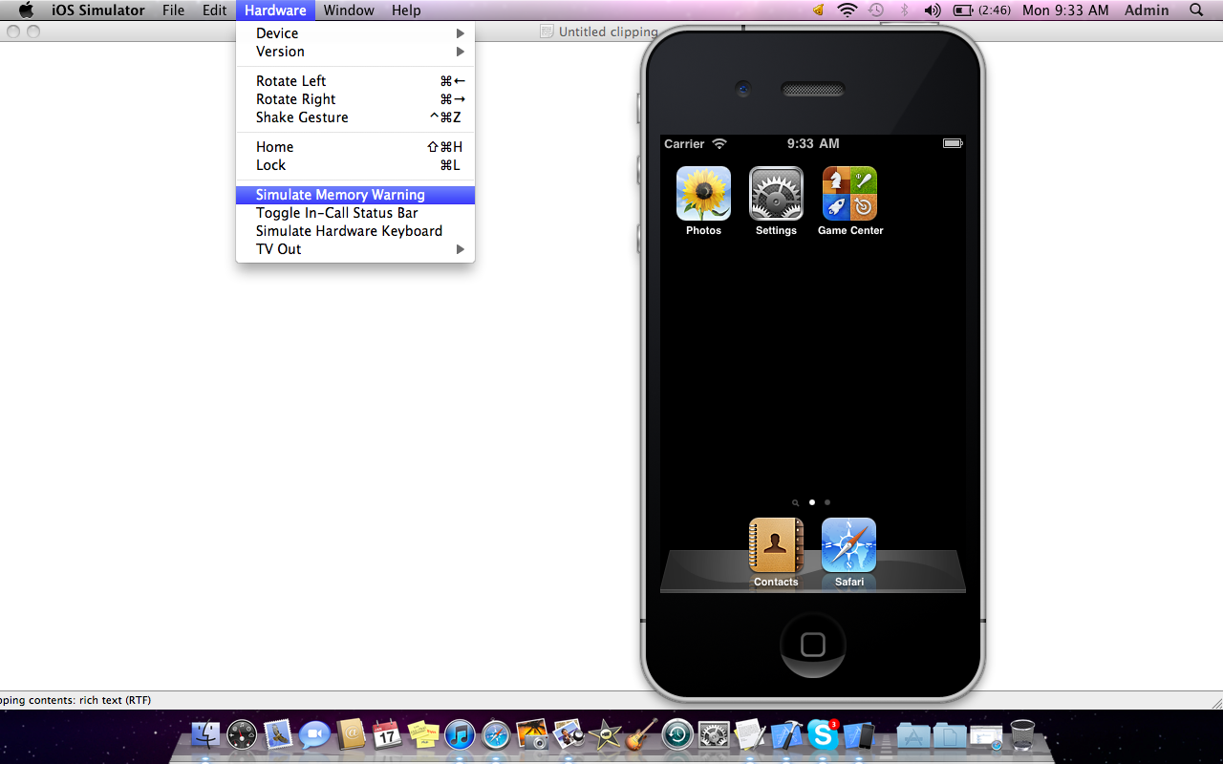

Slide 46
Xcode Static Analysis
Snow Leopard
Resolves retain/ release cycle
Manual Verification Essential

Slide 47
In View Controllers
Basic Building Blocks of an App.
Responds to Memory Warnings.
-(void)didReceiveMemoryWarning
{
}
-(void)viewDidUnload
{
}

Slide 48
Tuning performance & UI responsiveness
Do not Block the Main Thread.
Use memory efficiently.
Observing Low-Memory Warnings.

Slide 49
Conclusion

Slide 50
Contact
#2, 3 & 4th floors,
Above Chetty’s Corner
Kumarapark West
Serpentine Road
Bangalore: 560 020
Mobile: +91 88920 68680 (Bangalore)
Mobile: +91 98200 21035 (Mumbai)
Email: training@tappingaces.com

